Slide 1
Pecha Kucha Machu Picchu Pičku Materyj
ieva Kaminskaite
[ y e v a come.in.sky.te]
NUA

Slide 2
Pancake Faces

Slide 3
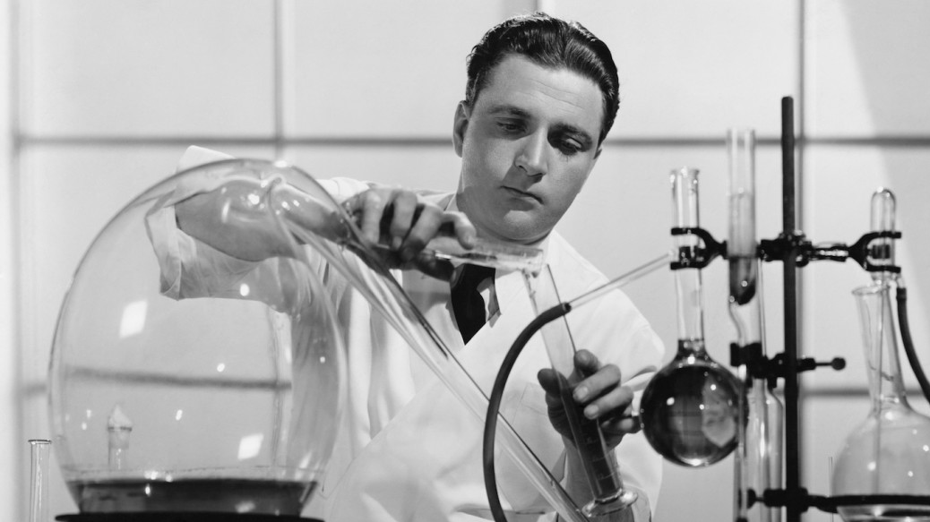
S N U
Self Negotiated Unit:
Experiments and getting hands dirty

Slide 4
A platform for various scenes and characters. Grotesque and humorous.

Slide 5
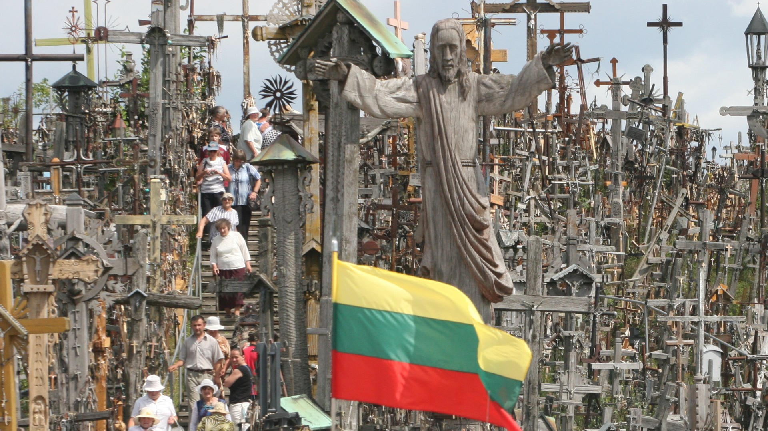
Back to the roots
Also, Happy Independence Day, Lithuania!

Slide 6
Leonardo Da Vinci ‘Last Supper’

Slide 8
White pen onto mirror

Slide 9
First 3

Slide 10
Finished

Slide 11
The End

