Slide 1
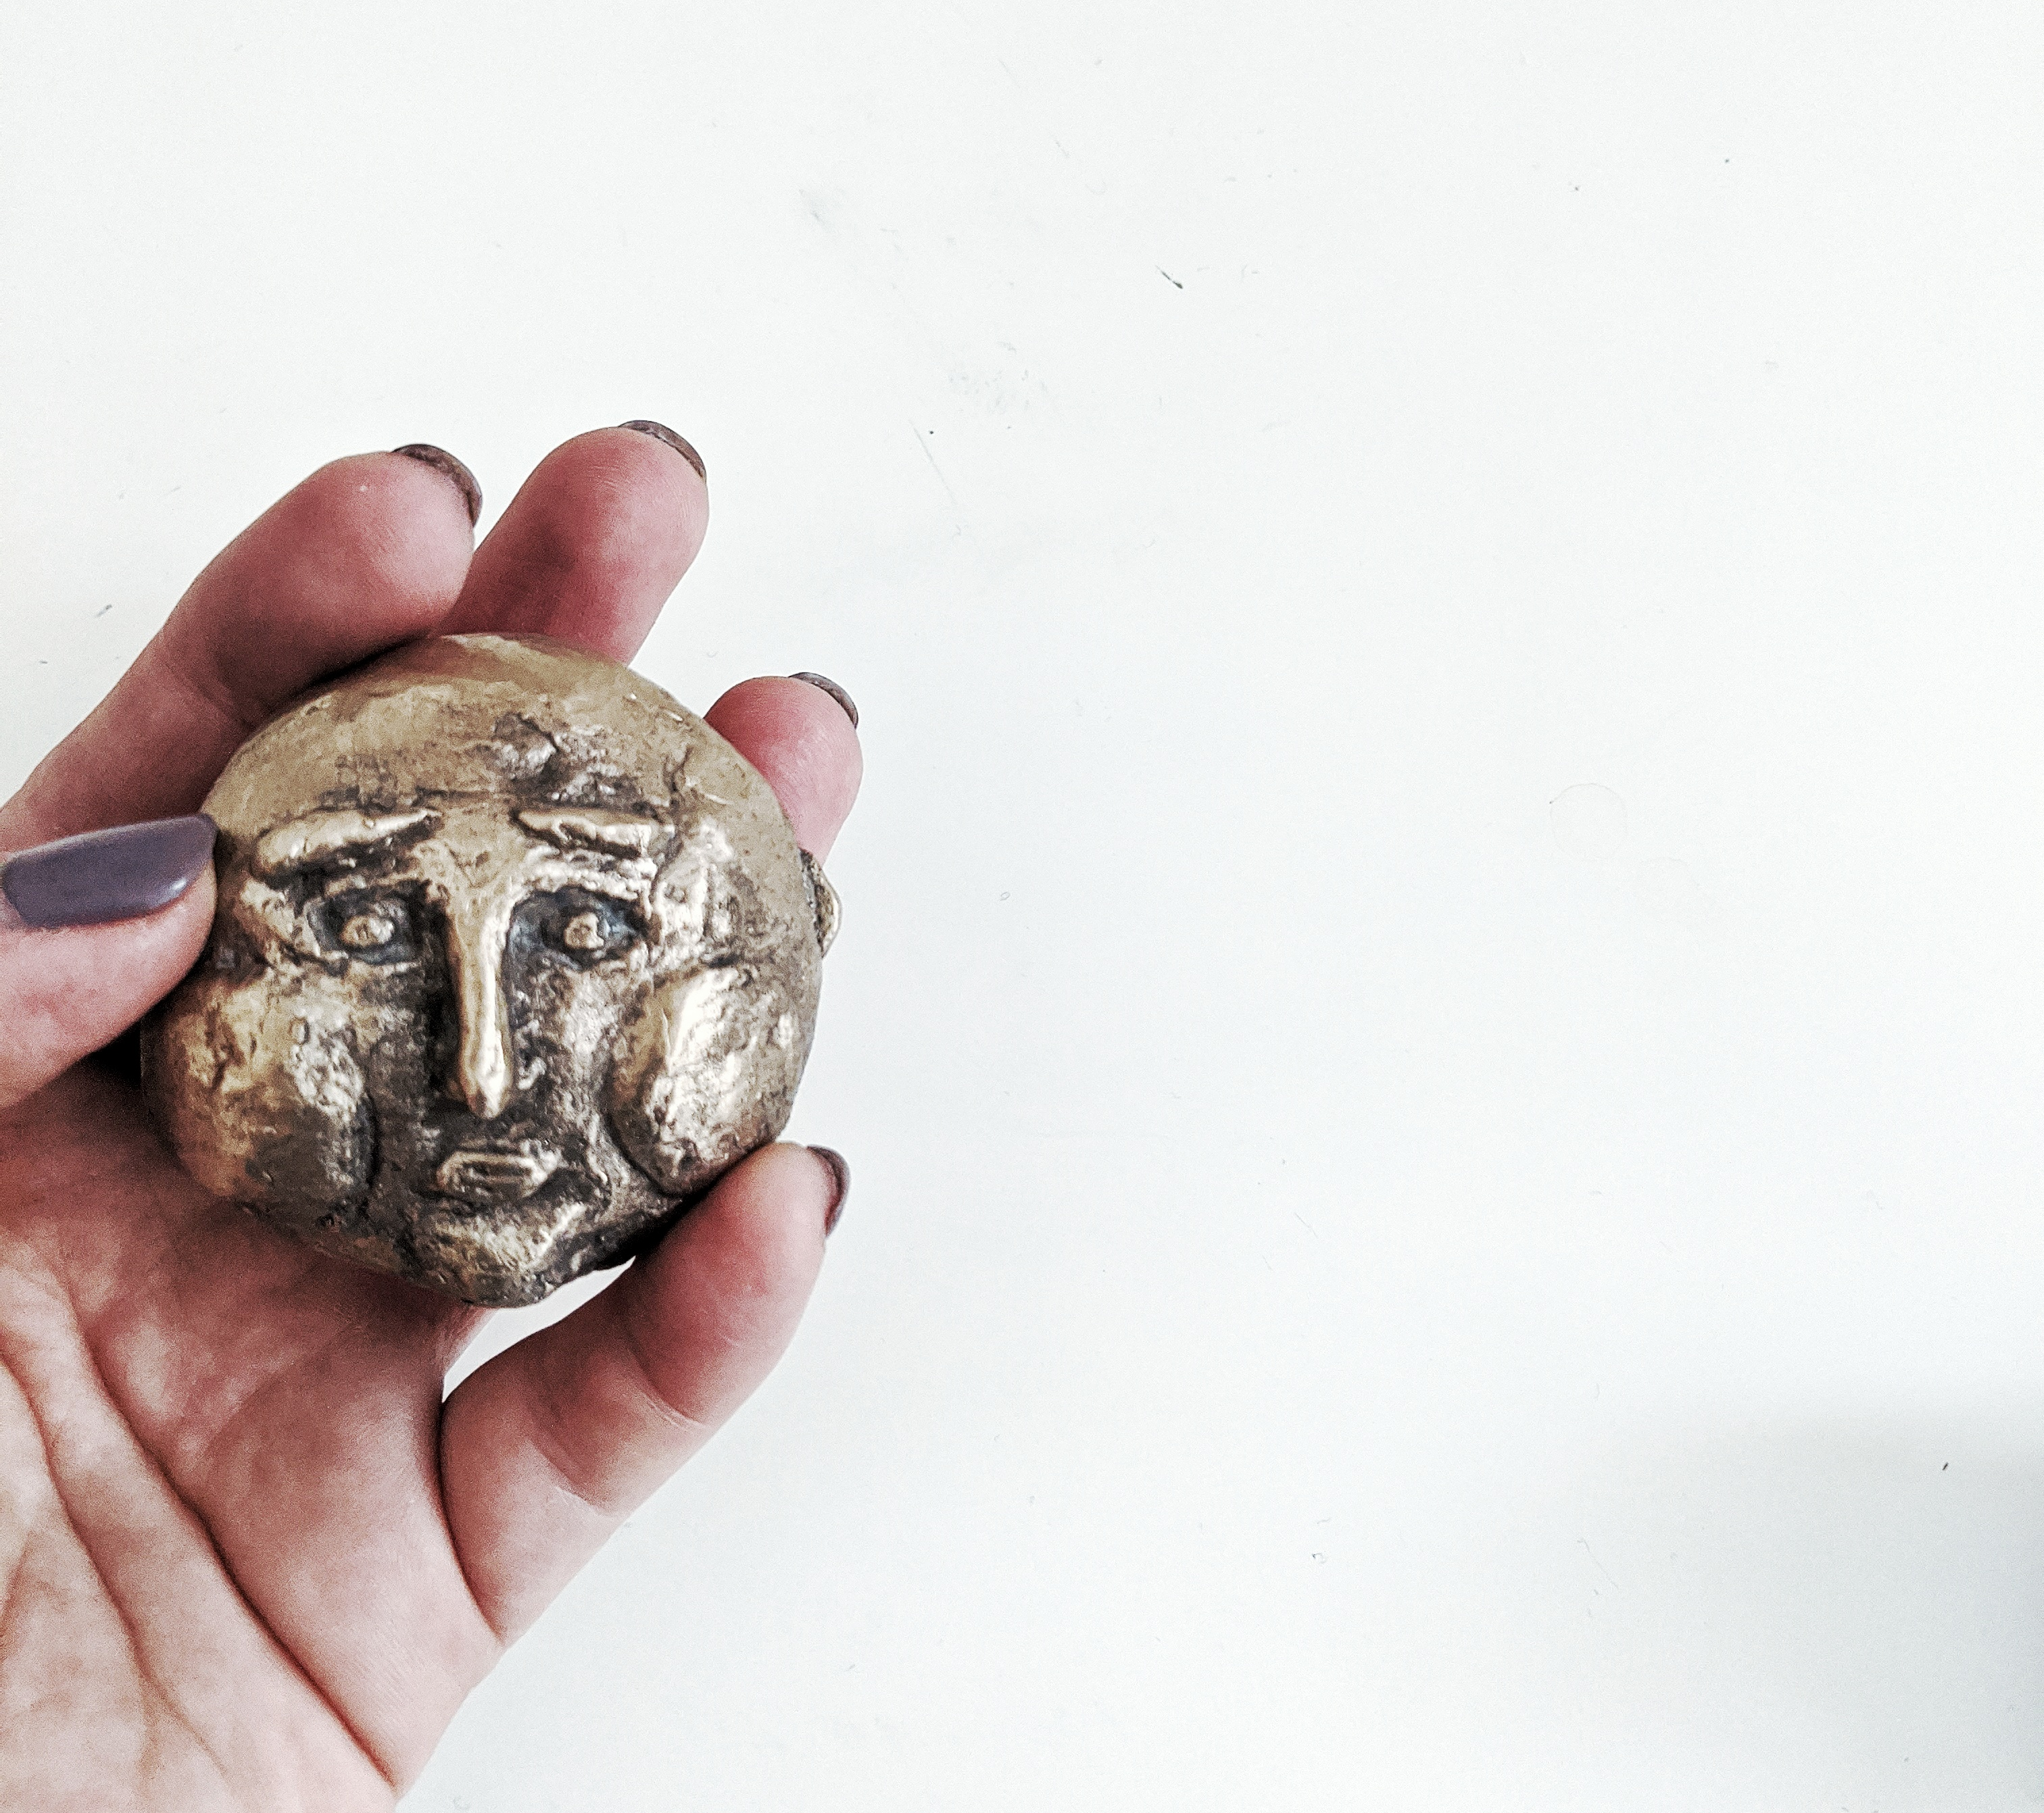
ieva Kaminskaite
MA Fine Art
MP
Pecha Kucha

Slide 2
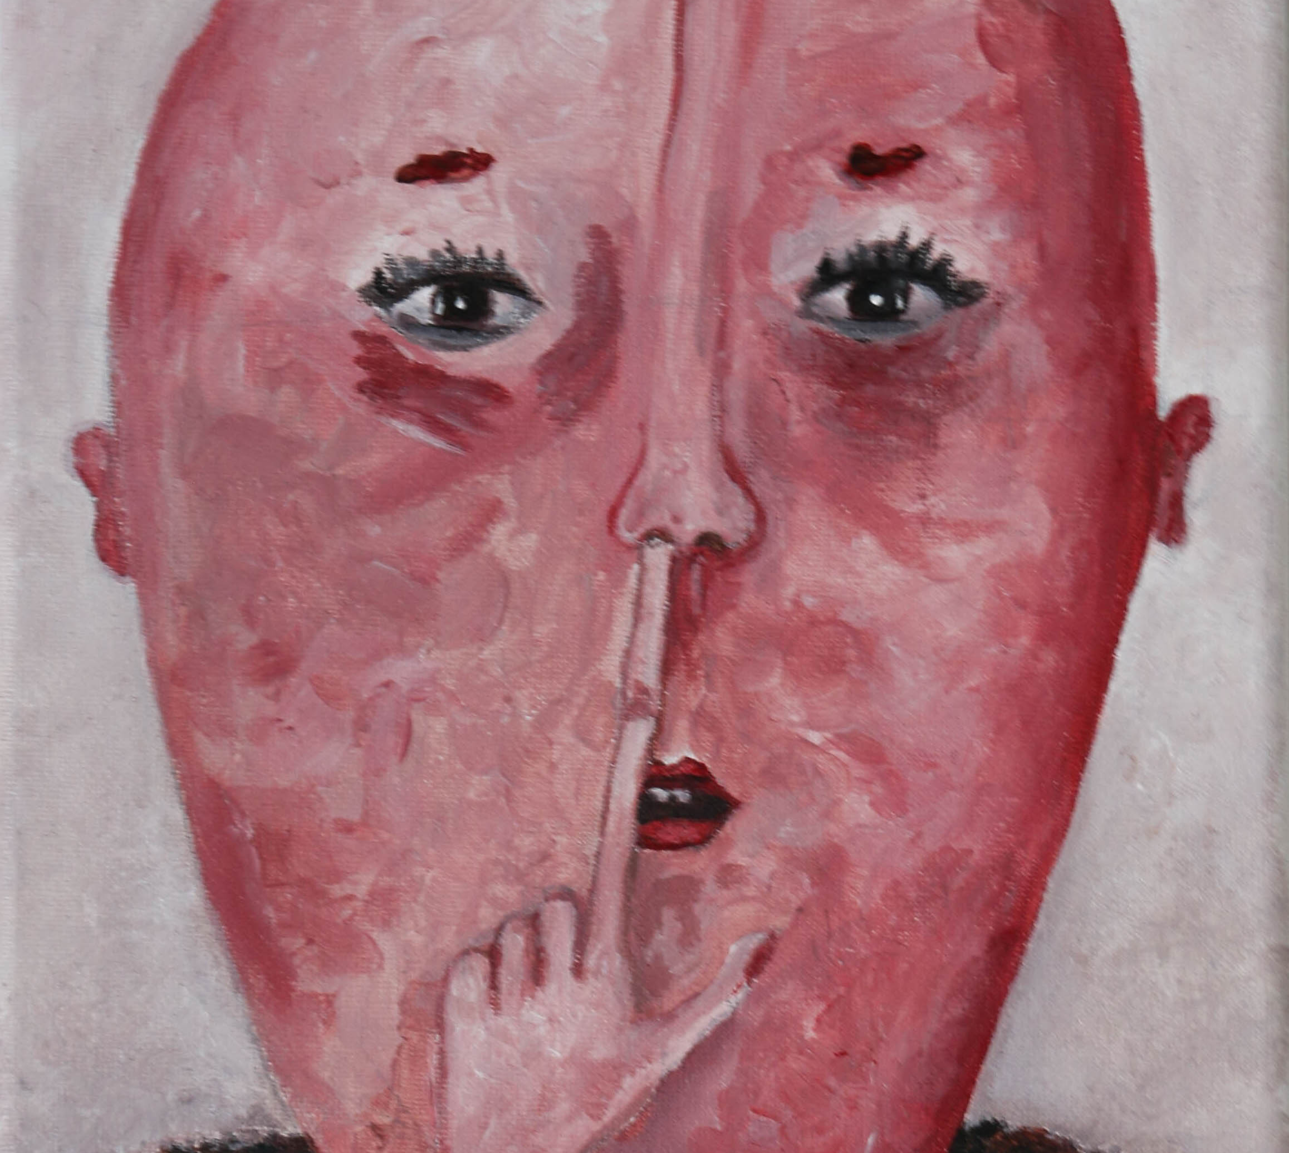
#pancakefaces
Started painting them in 2017
Not exactly round as it happens for first time pancakes
Reflecting humanity and its imperfections

Slide 3
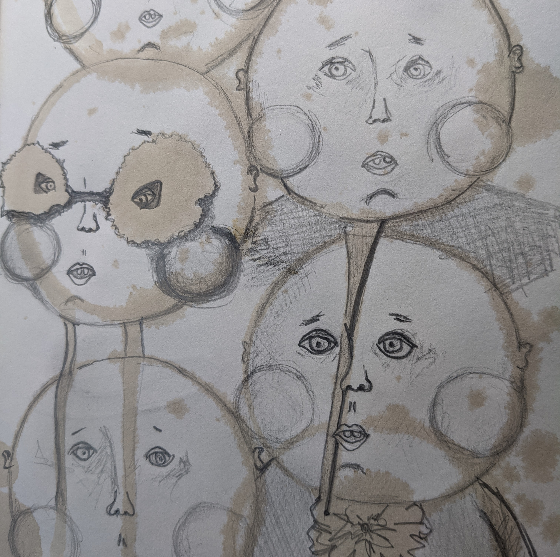
Round Shape
“Round shape – infinite goodness, the highest spiritual realm. The seat of all good, world of angels, higher elements. The realm of soul life.”
-Frederick Goodman “Magic Symbols” 1989

Slide 4
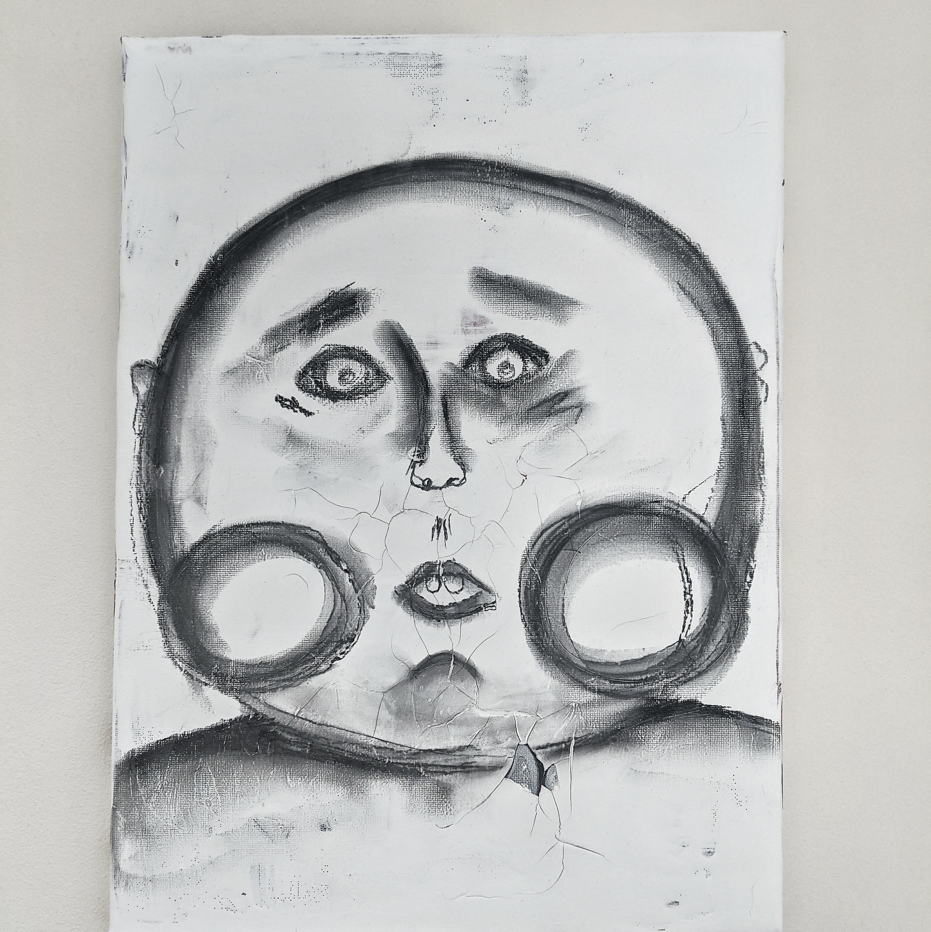
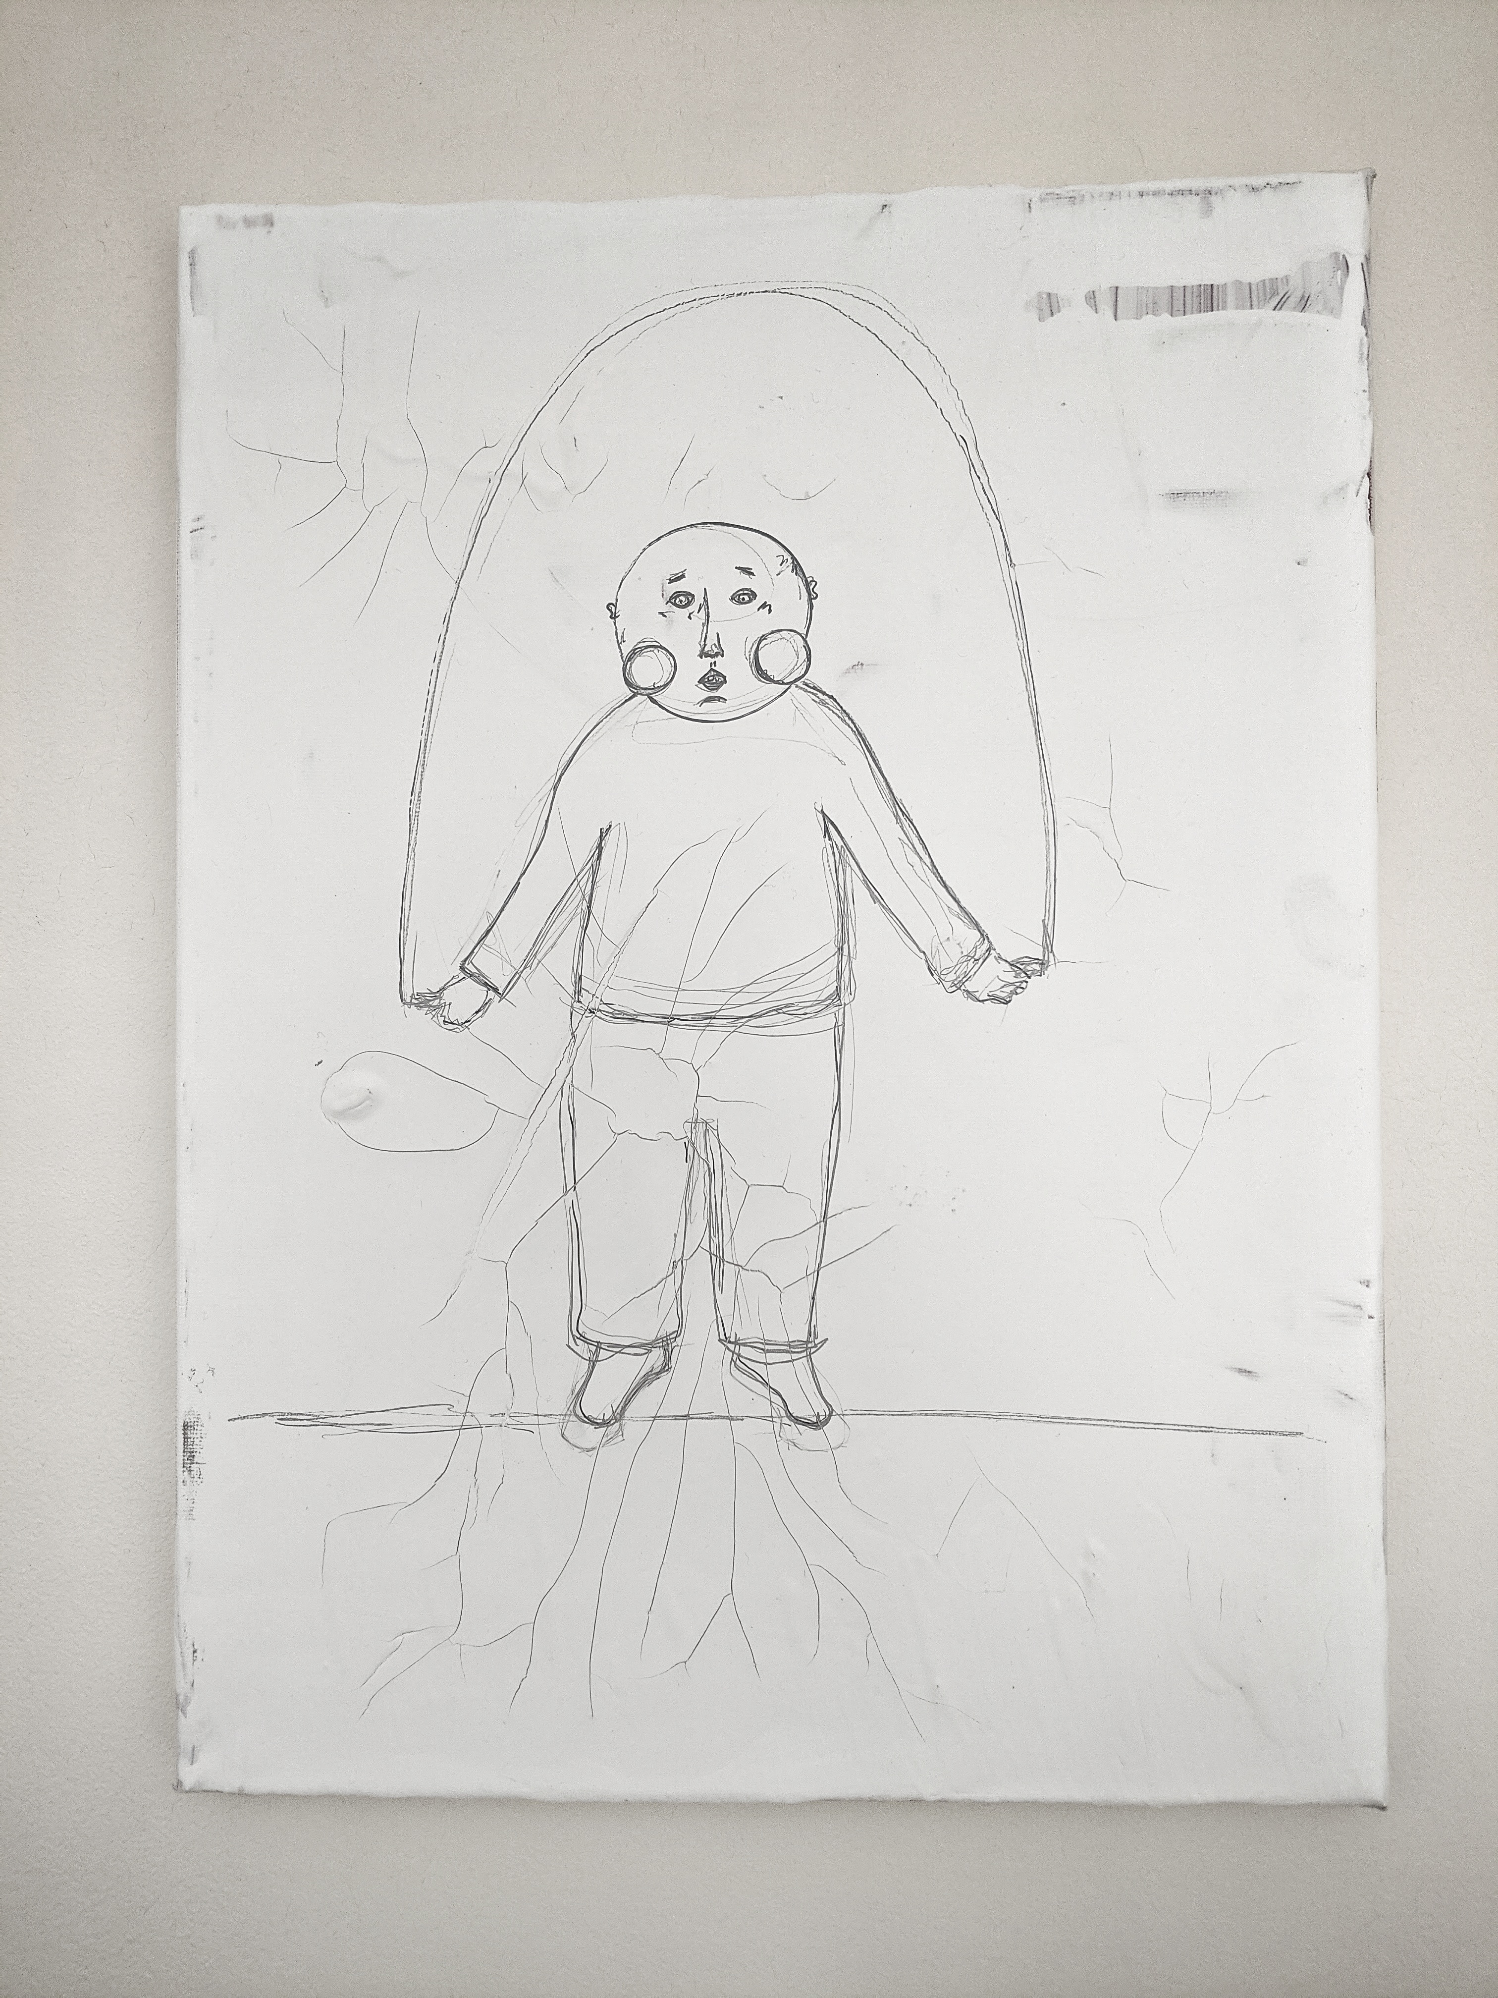
From comfort of the imaginary portrait to figure.

Slide 5
IN SPI RA TION
Human – Walking Bird
Lithuanian Poet Algimantas Baltakis
“Me. I’m a walking bird. Running on the ground. The one who promised to take off.”
Literature critic – D. Mitaite: “Walking bird – it’s a conflict between poet and society avoiding sinful earth.”

Slide 6
Other authors
Juozas Erlickas
Charles Baudelaire
Richard Bach – Johnathan Livingston Seagull

Slide 7
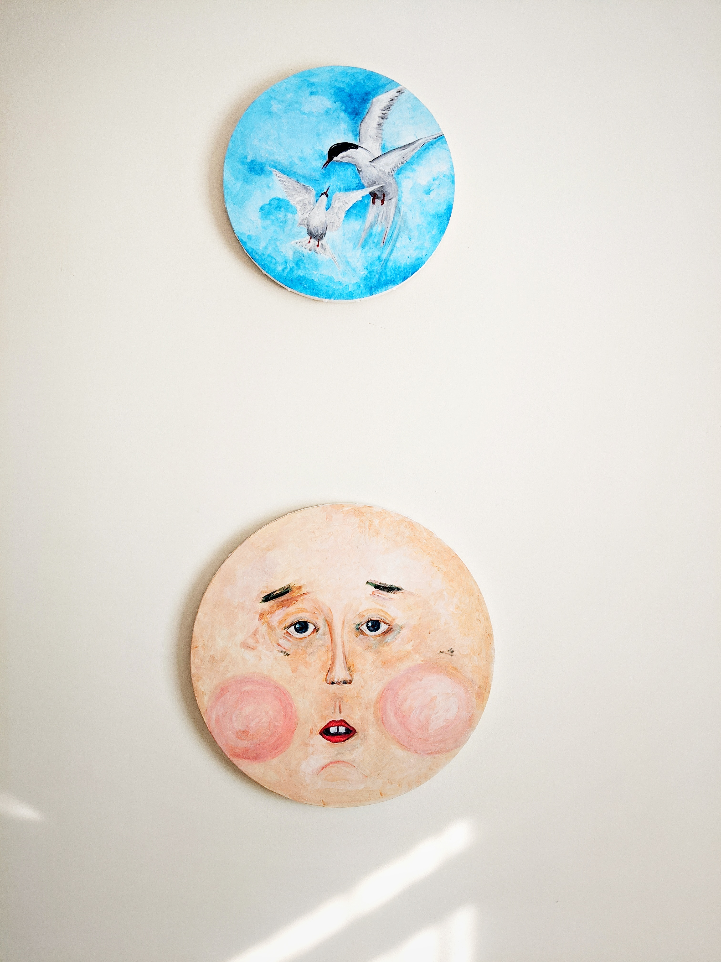
Painting

Slide 8
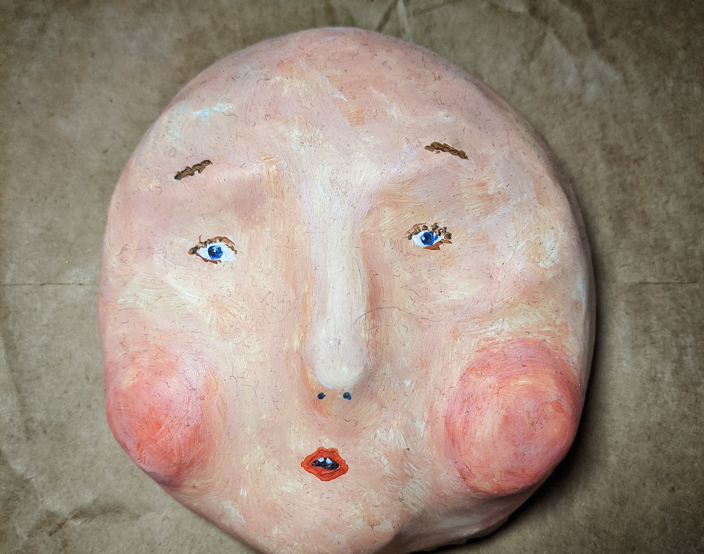
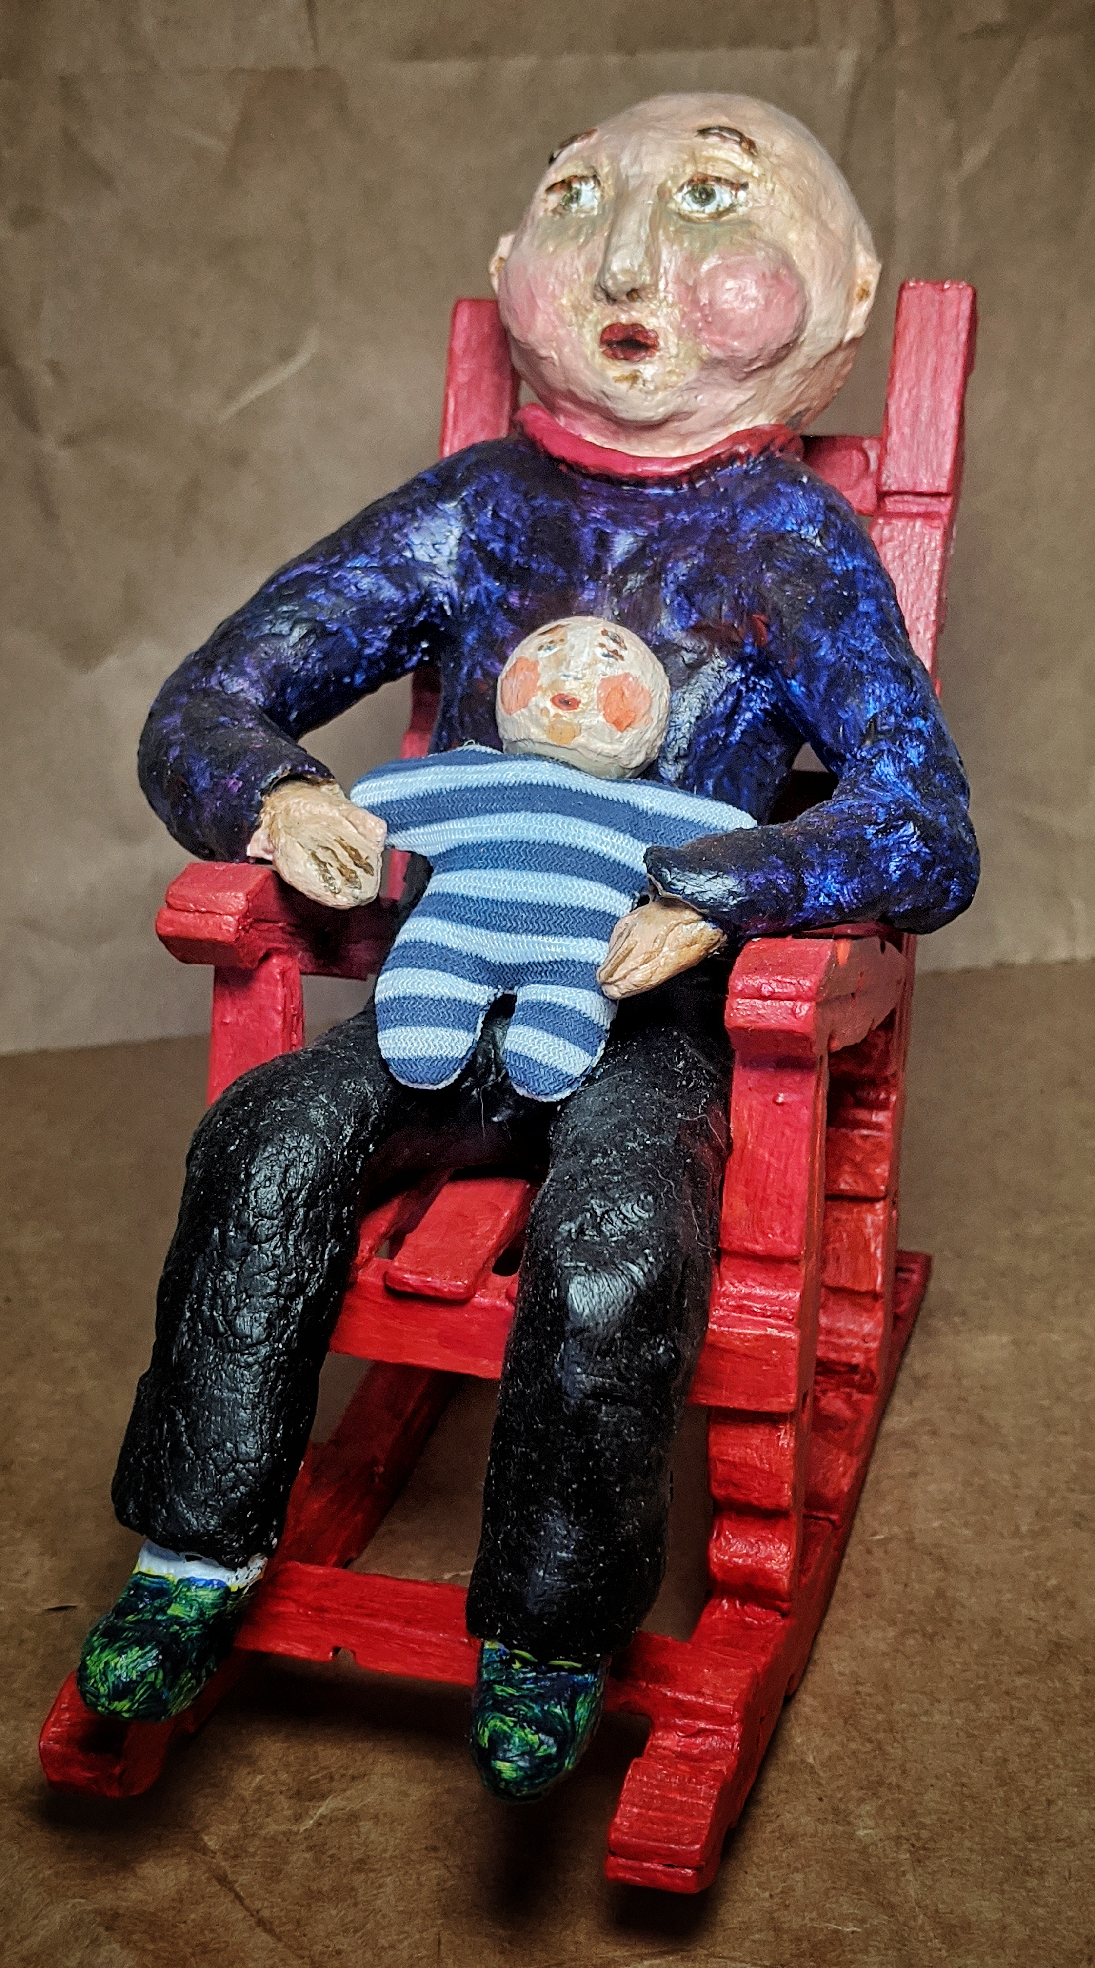
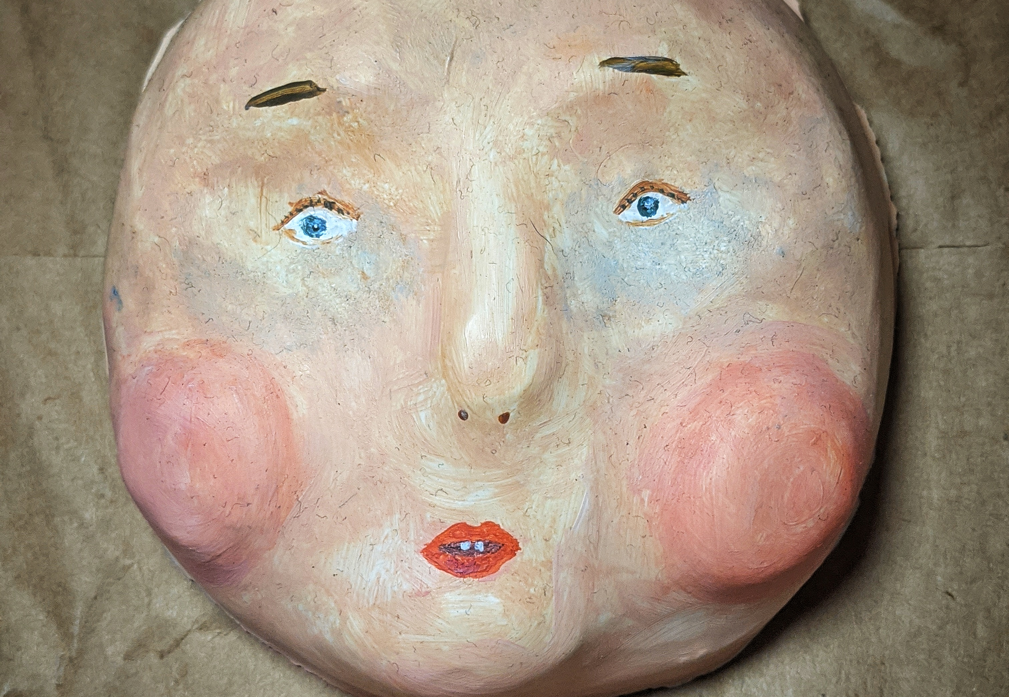
Sculpture

Slide 9
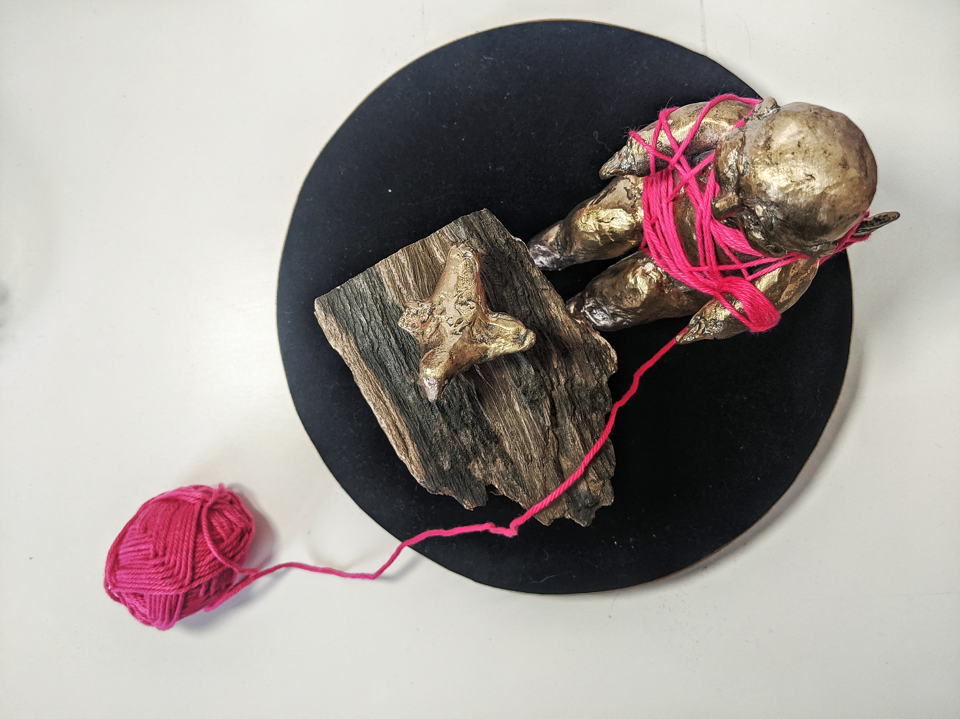
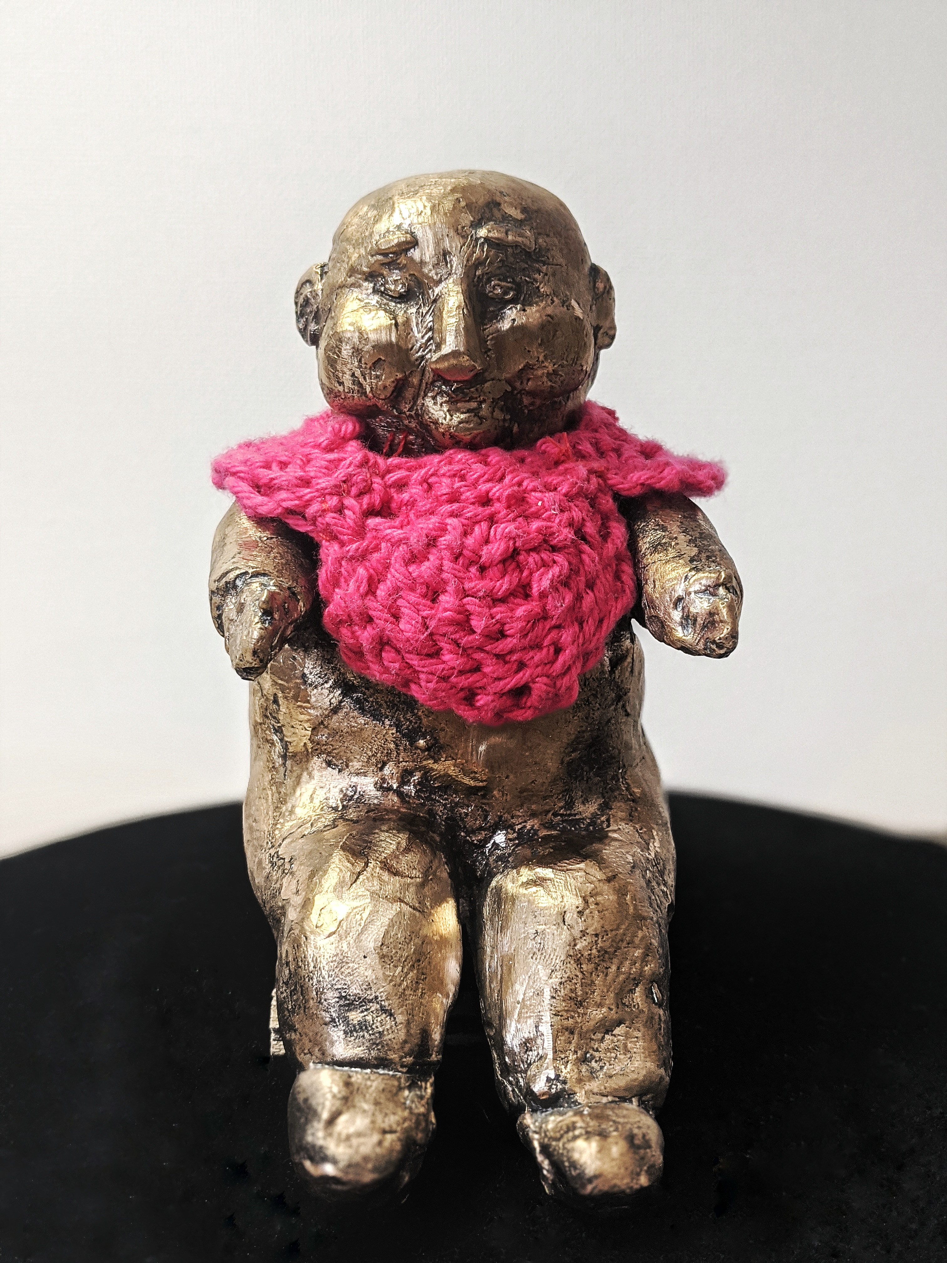
Bronze

Slide 10
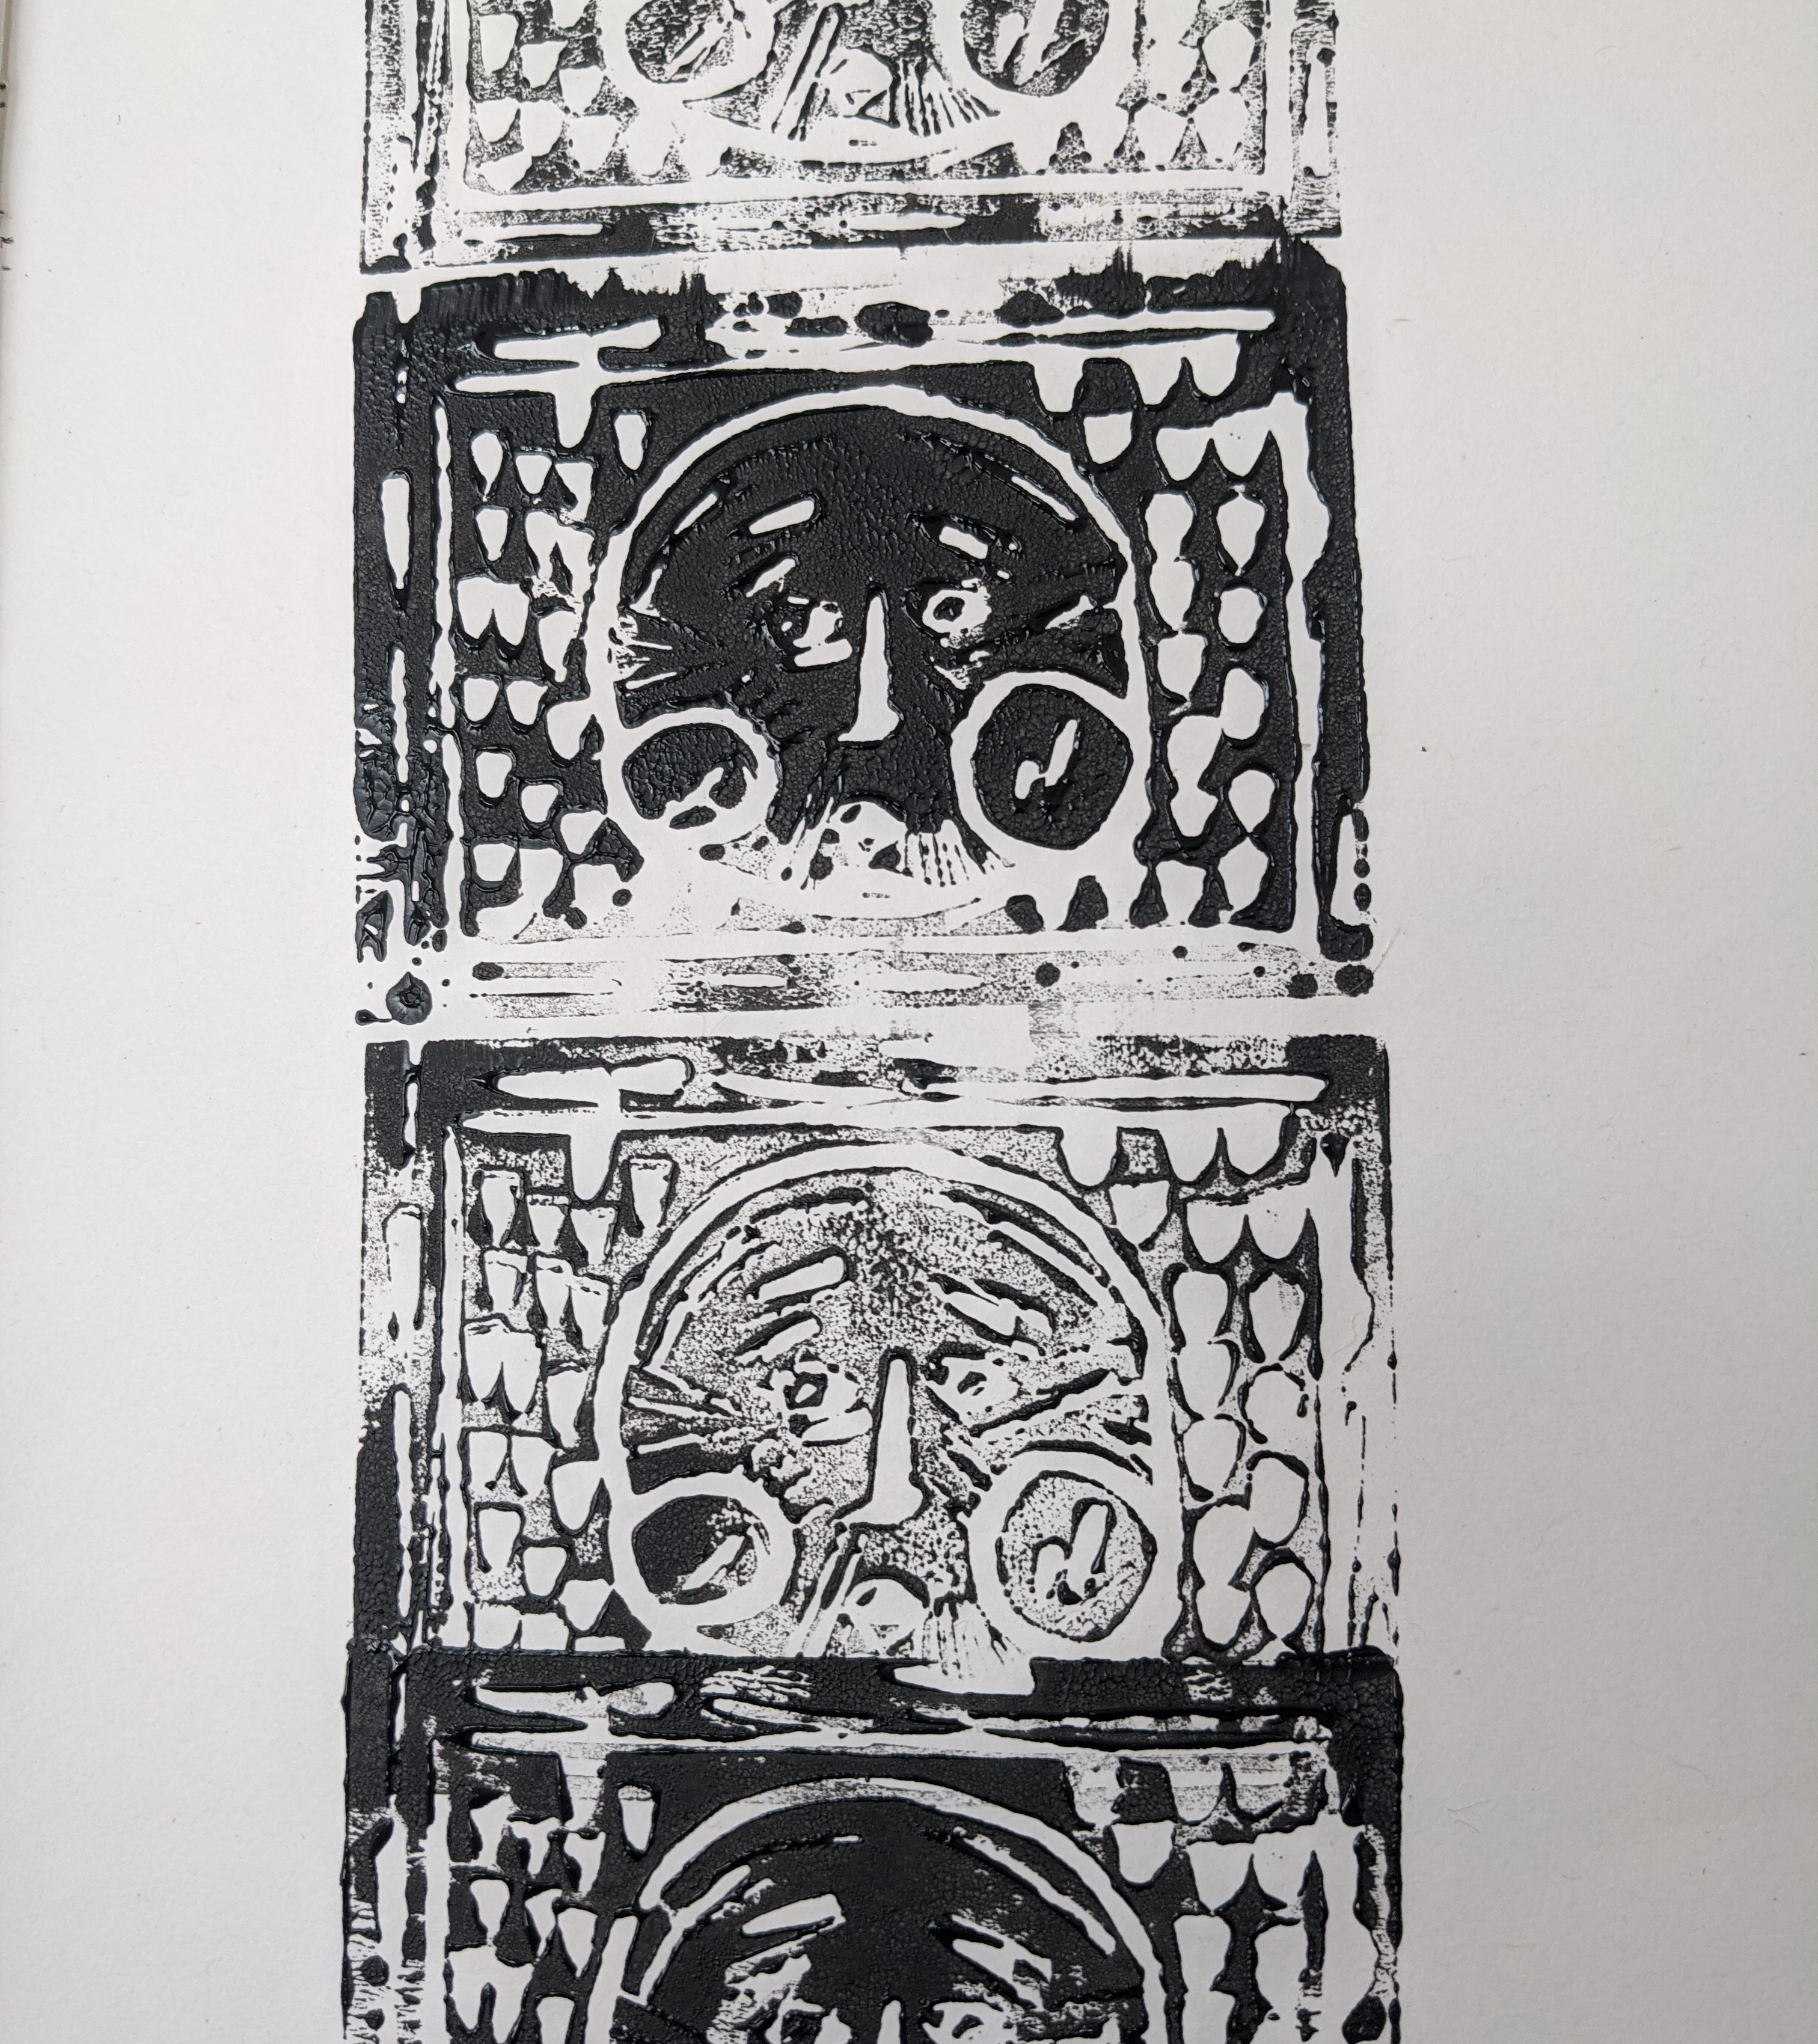
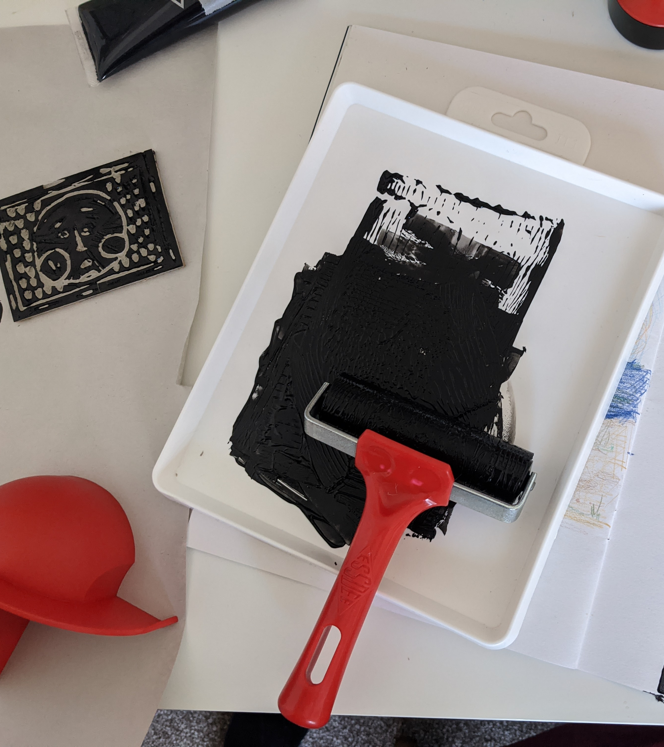
Lino Cutting

Slide 11
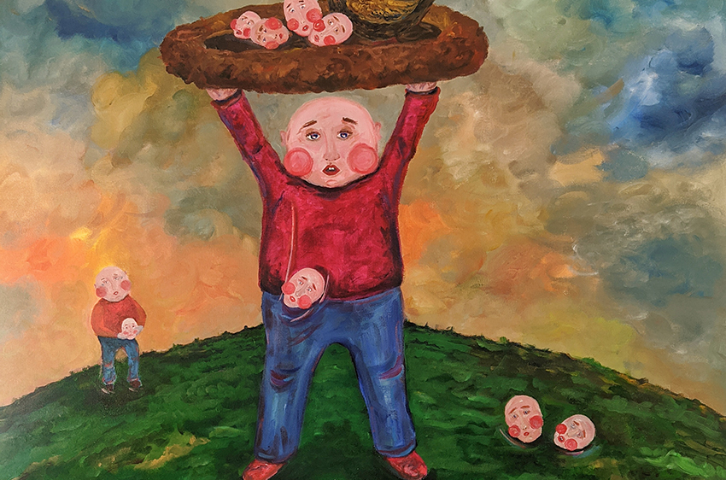
Storytelling

Slide 12
Poem

Slide 13
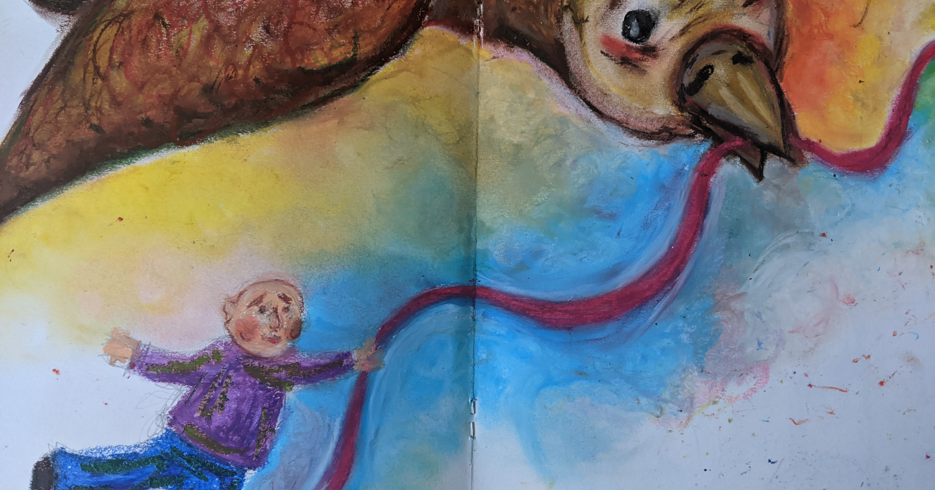
New ideas
Explore scenarios, mediums and the final look.

Slide 15
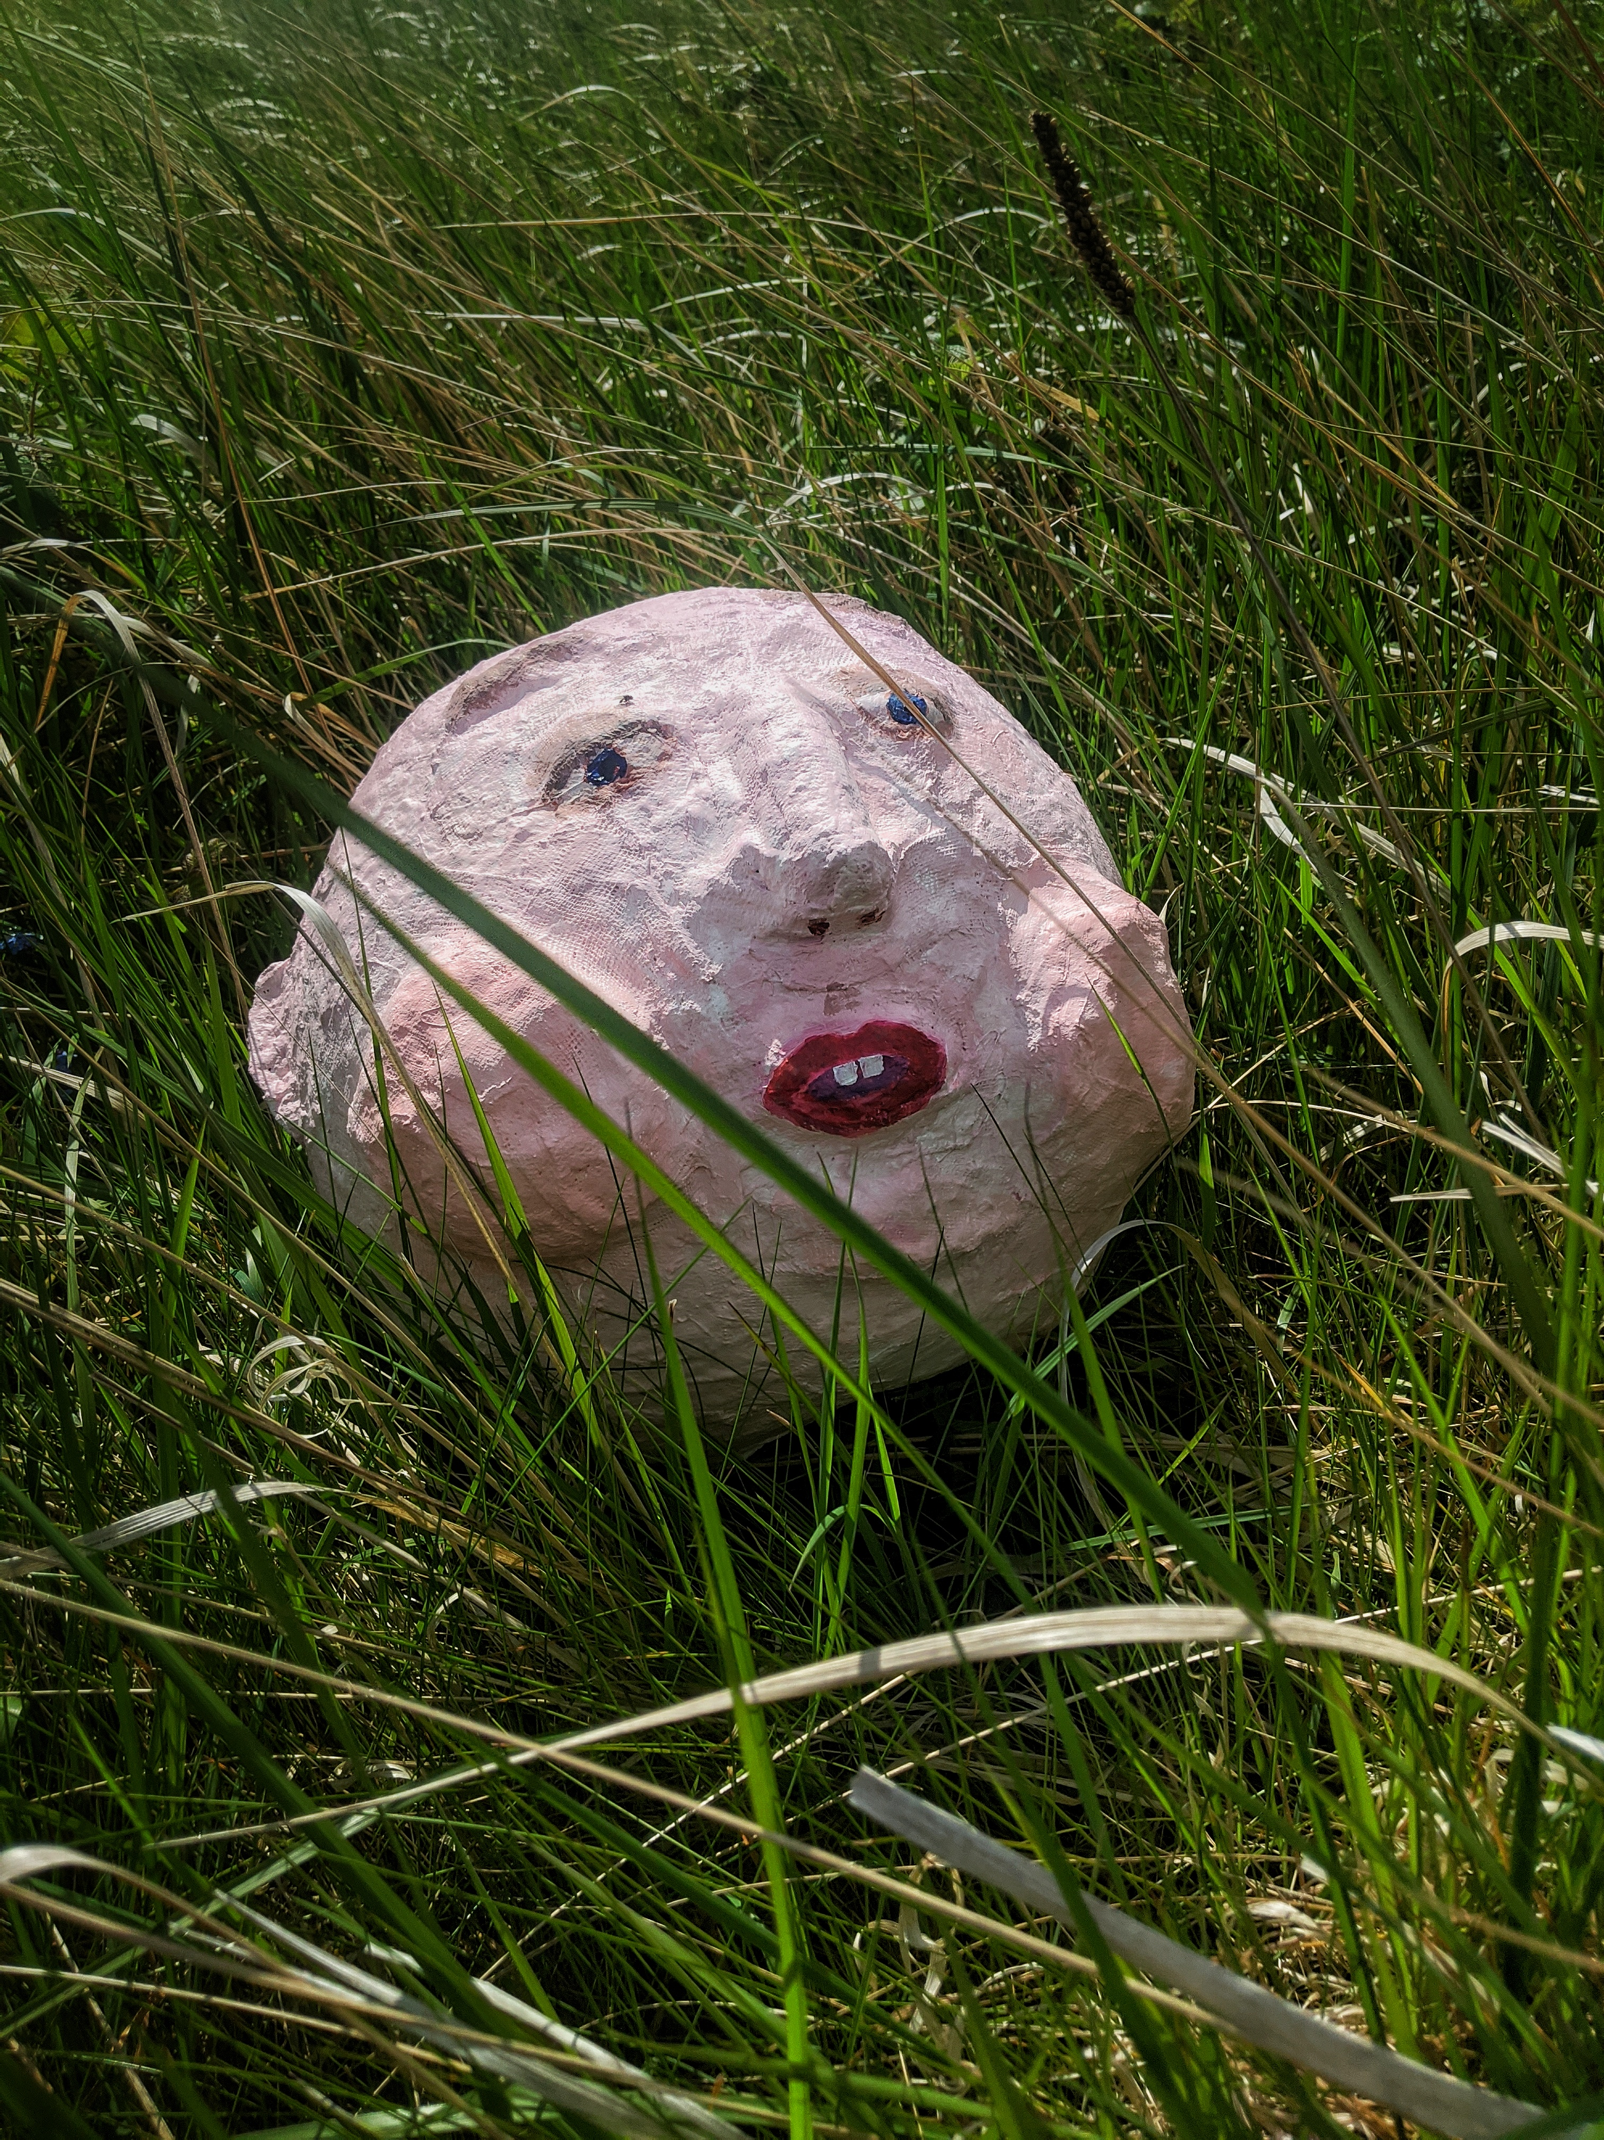
Spaces or Places

Slide 16
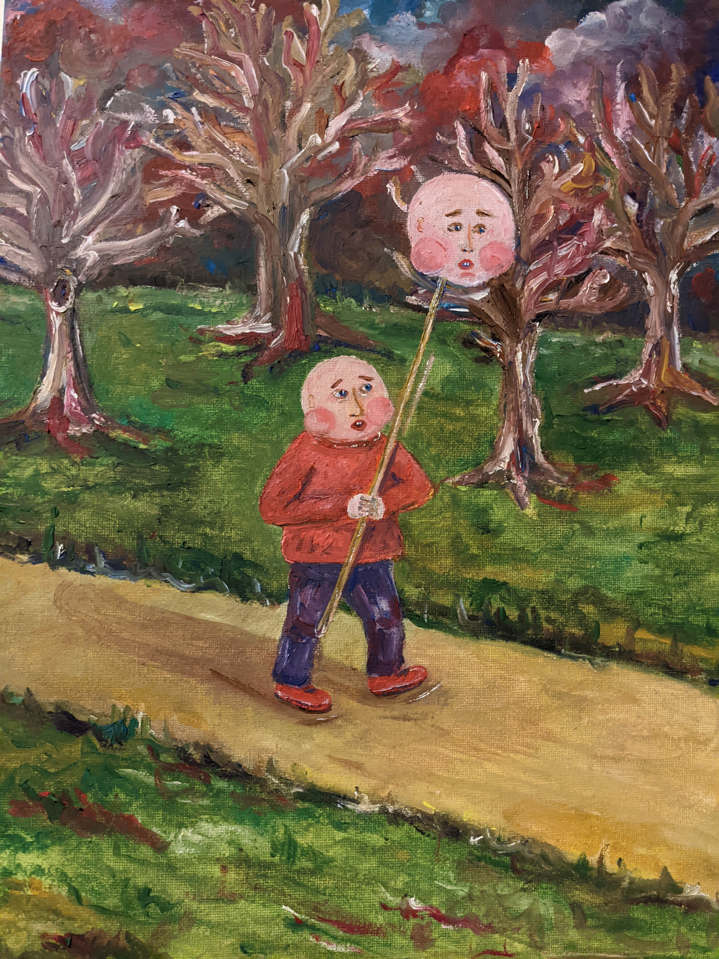
Thanks

